Slide 1
Lecture 4
Game Development

Slide 2
Position of a gameObject in Unity 3D
A position of a gameObject is an important entity for the following reasons:
when certain gameObject needs to be instantiated at a particular position
when a gameObject position needs to be checked at the time of collision
when one game object needs to follow another gameObject from an equal distance, for example camera
when a gameObject needs to get destroyed at a specific position

Slide 3
What is a Vector?
Vector is a particular datatype in unity that can hold position of a gameobject in the form of coordinates:
2 coordinates (x, y) if game is 2D
3 coordinates (x, y, z) if game is 3D

Slide 4
What is a Vector?
Vector3 will hold x, y, z coordinates in single variable
Example: Vector3 pos = new Vector(2, 3, 2)→ where pos is the name of the variable
Vector2 will hold x, y coordinates in single variable
Example: Vector2 pos = new Vector(2, 3)→ where pos is the name of the variable

Slide 5
How to access value of x, y, z exclusively
As pos variable will save 3 coordinates so:
pos.x will return value of x coordinate
pos.y will return value of y coordinate
pos.z will return value of z coordinate

Slide 6



Scenario 1:
If you want a camera to follow the car from an equal distance

Slide 7
Examples of Vector3 in Unity C#
public class Camera_Script : MonoBehaviour
{
public GameObject car;
private Vector3 offset; // this will store distance between camera and car
// Start is called before the first frame update
void Start()
{
offset = transform.position - car.transform.position; // set/initialize the value of offset
print("offset: " + offset);
}
// Update is called once per frame
void Update()
{
transform.position = car.transform.position + offset; // will add offset in car position on every update to make camera follow the car
}
}

Slide 8

Scenario 2:
If you want to instantiate a gameObject in the scene at any position

Slide 9
Examples of Vector3 in Unity C#
public class EnemyControllerScript : MonoBehaviour
{
public GameObject enemy;
// Start is called before the first frame update
void Start()
{
for (int i = 0; i < 25; i++) // instantiate 25 enemies
{
Vector3 enemy_pos = new Vector3(Random.Range(0, 1000), Random.Range(10, 15),
Random.Range(0, 1000)); // new Vector3(x,y,z)
Instantiate(enemy, enemy_pos, Quaternion.identity);
}
}
}

Slide 10
How to print a value in C#
print(variable_name);
Debug.Log(variable_name);
print(“hello_world”);
Very useful for checking value in a variable at particular point in the game.

Slide 11
Example 1
using UnityEngine;
using System.Collections;
public class MyGameClass : MonoBehaviour
{
void MyGameMethod()
{
// Message with a GameObject name.
Debug.Log("Hello: " + gameObject.name);
}
}

Slide 12
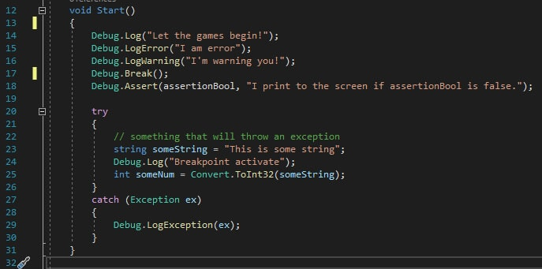
Example 2

Slide 13
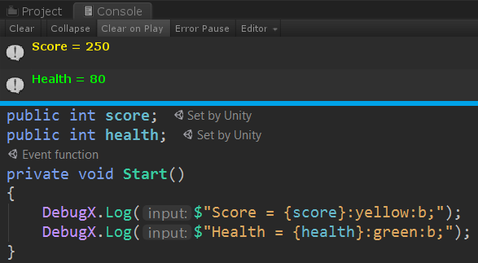
Example 3

Slide 14
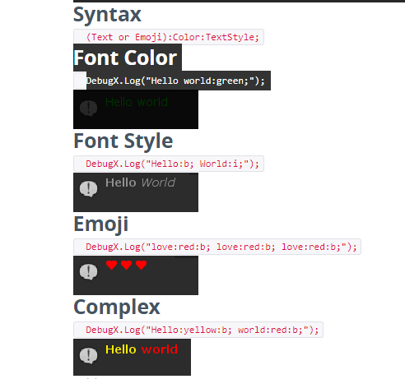
Example 4

Slide 15
Colliders in Unity
3D
Box Collider
Sphere Collider
Capsule Collider
Mesh Collider etc
2D will explore when we’ll make a 2D game

Slide 16
What is a Mesh?
Every mesh is set of triangles
Every triangle is made up of vertices and edges
Why triangles?
Basic 3d shapes like Sphere, Cube, Cylinder, Capsule, will have a specific collider found in unity
But for custom shapes the collider should be such that it forms the shape of the object.

Slide 17
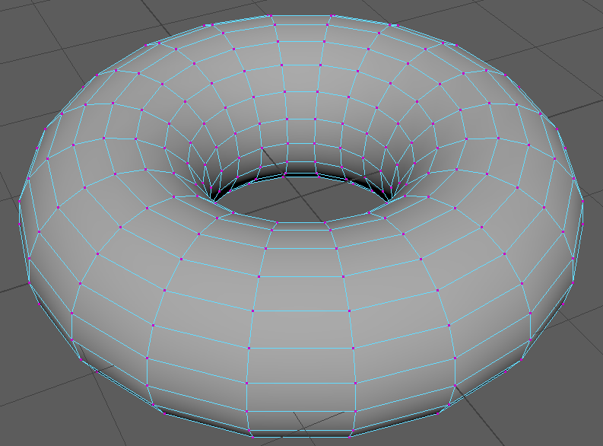
Custom Shapes

Slide 18
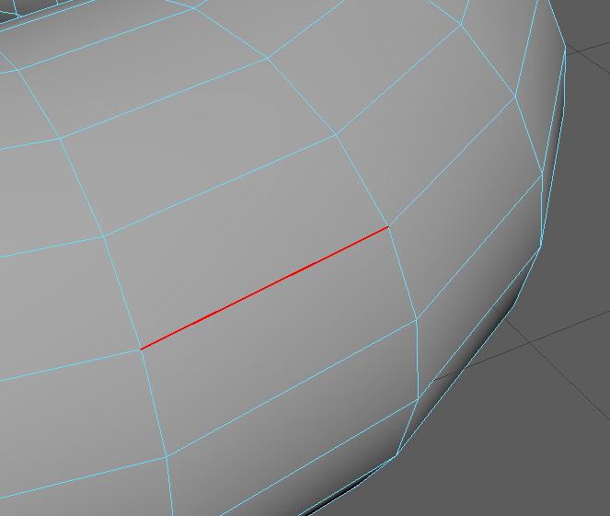
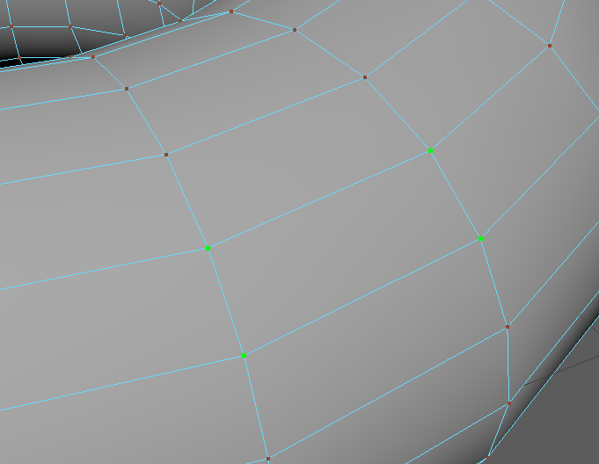
Custom Shapes
Notice the shapes and edges

Slide 19
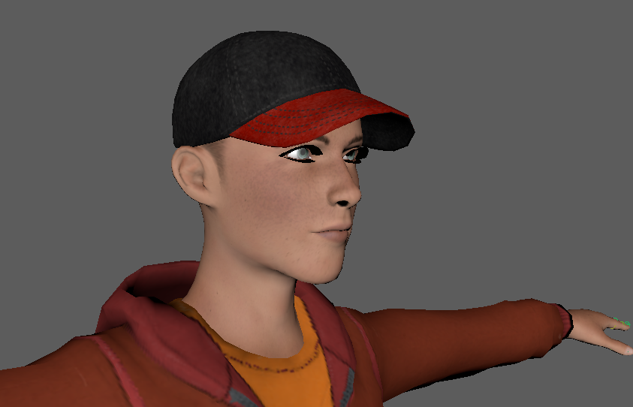
Model

Slide 20
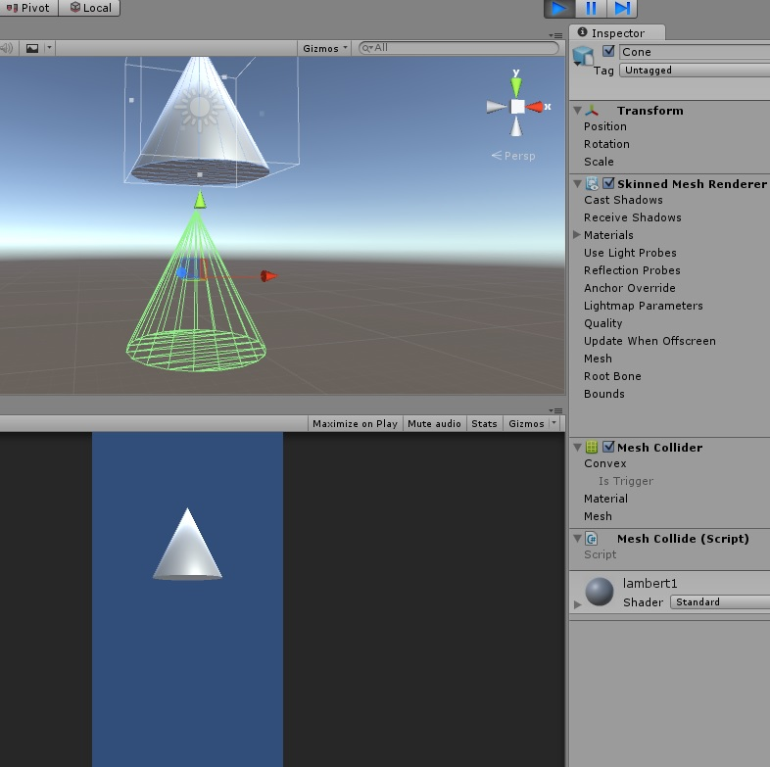
Mesh collider

Slide 21
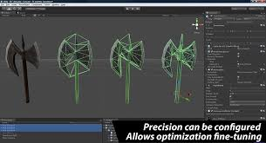
Mesh collider

Slide 22
Convex Mesh Collider
Explore?
Can Mesh collider always detect collision?

